Slide 1

Unsupervised Learning
Lecture 12 – HCCDA-AI
Dr. Muhammad Sajjad
RA: Imran Nawar
13 July 2025

Slide 2
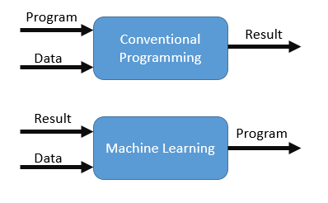
Traditional Programming vs Machine Learning
Traditional Programming
Approach: Write explicit rules and logic for specific tasks.
Input: Rules (logic) + Data → Output.
Key Focus: Programmer defines all possible scenarios.
Example:
Use if-else statements to classify emails as spam or not.
Machine Learning
Approach: Learn patterns from data to make predictions or decisions.
Input: Data + Output (labels) → Learns Rules (Model).
Key Focus: Relies on high-quality training data.
Example:
Train a spam classifier with labeled examples of spam and non-spam emails.
Key Difference
Traditional Programming: Fixed rules; limited flexibility.
Machine Learning: Adaptive rules; improves with more data.
Notes:
In traditional programming, you tell the computer what to do. In machine learning, you show it examples, and it figures out what to do.

Slide 3
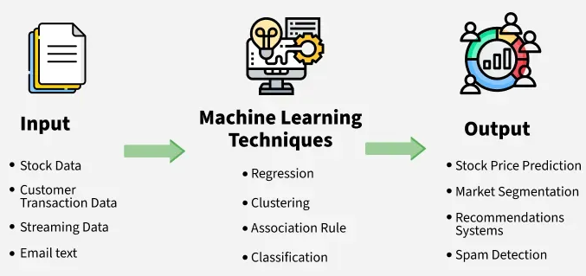
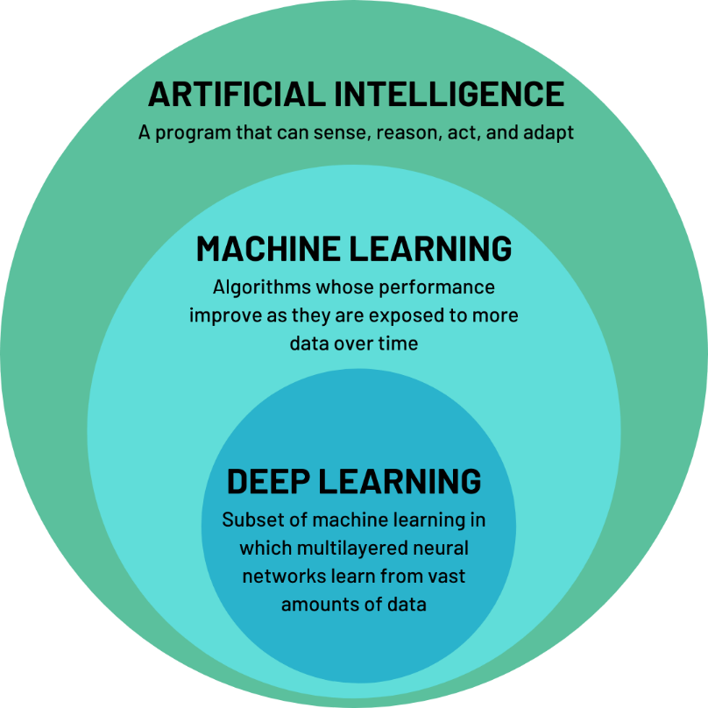
Introduction To Machine Learning
Machine learning is the science (and art) of programming computers so they can learn from data.
[Machine learning is the] field of study that gives computers the ability to learn without being explicitly programmed.
— Arthur Samuel, 1959
“A computer program is said to learn from experience E with respect to some task T and some performance measure P, if its performance on T, as measured by P, improves with experience E.”
—Tom Mitchell, 1997
[Machine Learning means a computer improves at a task (T) over time as it gains experience (E), measured by a performance metric (P)].
Notes:
Machine Learning was developed as a new capability for computers.
- Machine Learning is about building systems that can learn from data.
- Machine Learning addresses the question of how to build computers that improve automatically through experience.

Slide 4
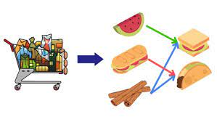
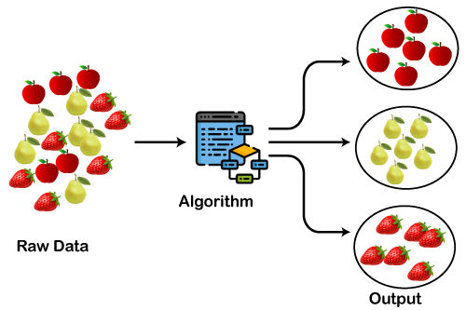
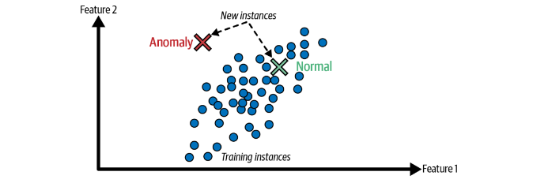
Types of Machine Learning
Unsupervised Learning
Unsupervised Learning involves training a model on data that does not have labeled responses.
The model tries to find hidden patterns or intrinsic structures in the input data.
Common Tasks in Unsupervised Learning:
Clustering:
Grouping similar data points together.
For example, customer segmentation in marketing, where customers are grouped based on purchasing behavior.
Anomaly Detection:
Identifying outliers or unusual data points that do not conform to the expected pattern.
For example, detecting fraudulent transactions in financial systems.
Association:
Discovering rules that describe large portions of the data.
For example, market basket analysis in retail, where associations between products bought together are identified.
Notes:
Intrinsic: اندرونی
Unsupervised Learning: Find something interesting in unlabeled data.

Slide 5
Difference Between Supervised and Unsupervised Learning
Feature | Supervised Learning | Unsupervised Learning
Data | Labeled | Unlabeled
Goal | Learn from input-output pairs | Find hidden patterns in data
Examples | Classification, Regression | Clustering, PCA, Anomaly Detection
Output | Predictive model | Data patterns or groups
Notes:
There are no labels, and the goal is to find patterns, structures, or relationships in the data.
The concept of "inference" is different:
In clustering (e.g., K-Means), the model assigns new data points to clusters, but it does not "predict" labels like supervised learning.
In dimensionality reduction (e.g., PCA), new data can be projected into the learned lower-dimensional space.
In anomaly detection, the model identifies whether a new data point deviates from the learned normal pattern.

Slide 6


Supervised learning
Training set:

Slide 7
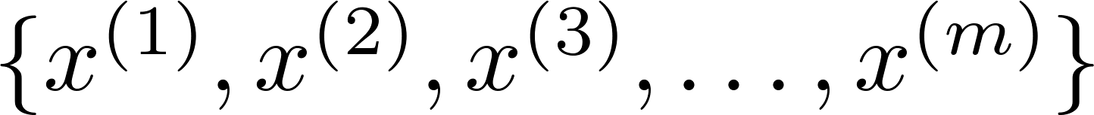
Unsupervised learning
Training set:

Slide 8
Key Techniques of Unsupervised Learning

Slide 9



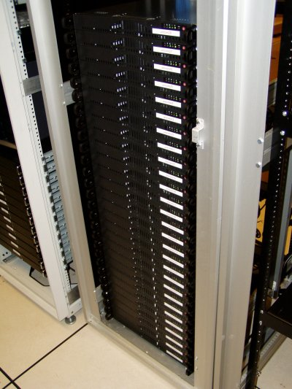
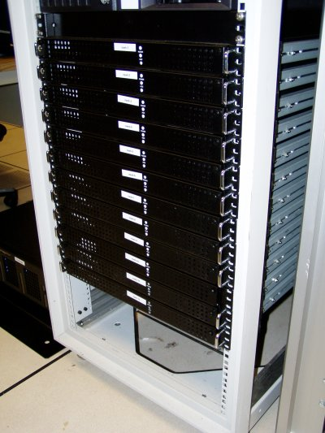
Clustering
Grouping similar data points together.
For example, customer segmentation in marketing, where customers are grouped based on purchasing behavior.
Applications of Clustering
Social network analysis
Market Segmentation
Image credit: NASA/JPL-Caltech/E. Churchwell (Univ. of Wisconsin, Madison)
Organize computing clusters
Astronomical data analysis
Notes:
The machine learning algorithm for clustering is K-Means Clustering, which groups data points into K clusters based on their similarity. Another popular algorithm is Hierarchical Clustering, which builds a tree of clusters for better visualization of relationships.

Slide 10
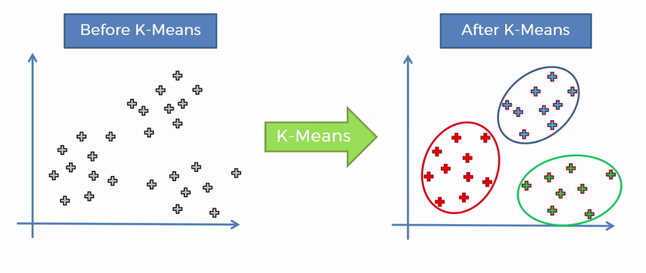
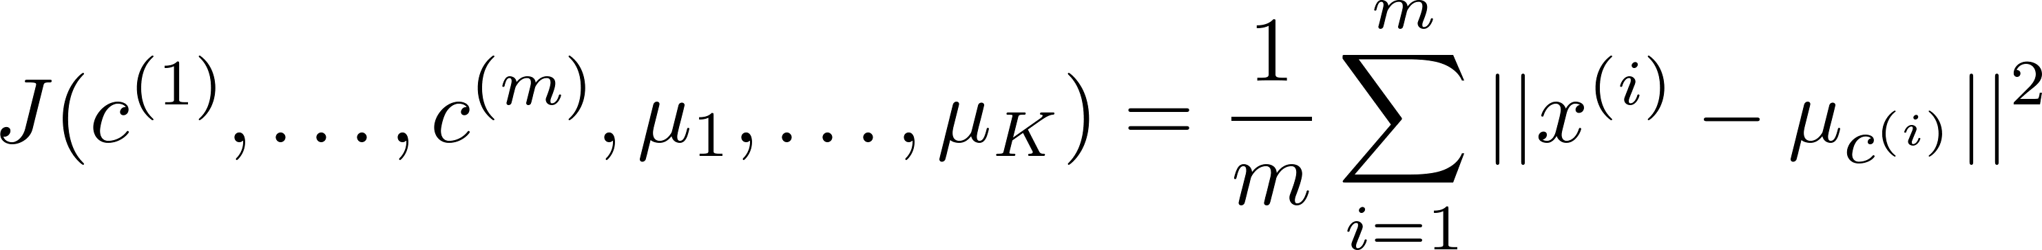

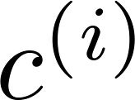
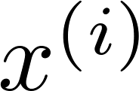
K-Means Clustering
Algorithm Steps:
Select the number of clusters K.
Randomly initialize K cluster centroids.
Repeat until convergence:
Assign each data point to the nearest centroid.
Update centroids by computing the mean of all assigned points.
Optimization Objective
Minimize the sum of squared distances between data points and their assigned cluster centroid:
J =
where is the centroid of cluster to which point belongs.
Other Clustering Techniques
Hierarchical Clustering: Builds a hierarchy of clusters.
DBSCAN: Detects clusters based on density.
Notes:
A centroid is the center point of a cluster in clustering algorithms like K-Means.
It represents the mean (average) of all data points assigned to that cluster. The centroid moves during each iteration as data points are reassigned and the cluster’s mean is recalculated.

Slide 11
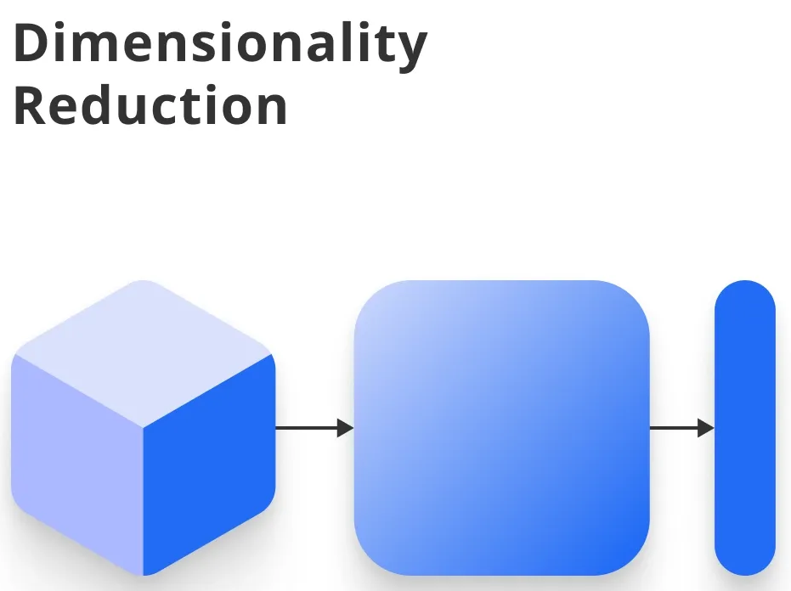
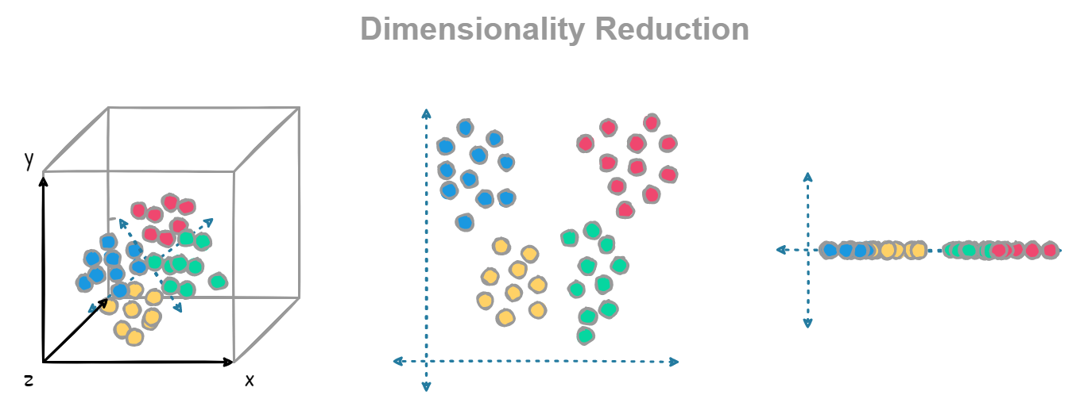
Dimensionality Reduction
Reduces the number of features in data while preserving meaningful information.
Used for visualization, noise reduction, and improving ML efficiency.
Principal Component Analysis (PCA)
Concept
Projects data onto a lower-dimensional space using eigenvectors of the covariance matrix.
Finds the directions (principal components) that maximize variance.
Algorithm Steps
Normalize data (zero mean and unit variance).
Compute the covariance matrix.
Compute eigenvalues and eigenvectors.
Select top K eigenvectors to reduce dimensions.
Transform data using the selected eigenvectors.
Applications
Face recognition
Feature extraction in ML models
Noise filtering
Notes:
The machine learning algorithm for dimensionality reduction is Principal Component Analysis (PCA), which transforms high-dimensional data into fewer dimensions while preserving the most important variance. Other techniques like t-SNE (t-Distributed Stochastic Neighbor Embedding) are also used for visualizing complex datasets.

Slide 12
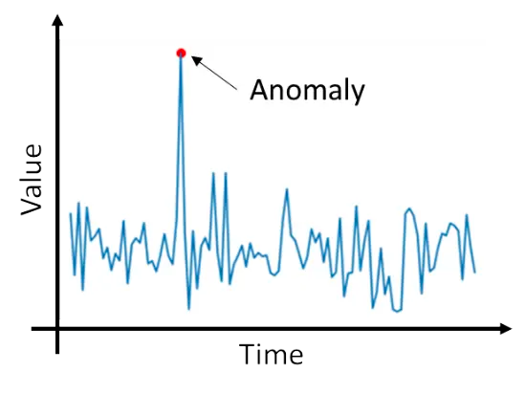
Anomaly Detection
Identifying data points that deviate significantly from the norm.
Used in fraud detection, cybersecurity, and predictive maintenance.
Example:
Fraud Detection
Features of a user’s transactions are monitored.
If a transaction deviates significantly from past behavior, it is flagged as fraudulent.
Anomaly Detection Algorithm
The machine learning model for anomaly detection is Gaussian Mixture Models (GMM), which estimates the probability distribution of the data and detects anomalies as low-probability points. Another model used is Autoencoders, which reconstruct normal data patterns and flag deviations as anomalies.
Notes:
The machine learning model for anomaly detection is Gaussian Mixture Models (GMM), which estimates the probability distribution of the data and detects anomalies as low-probability points. Another model used is Autoencoders, which reconstruct normal data patterns and flag deviations as anomalies.

Slide 13
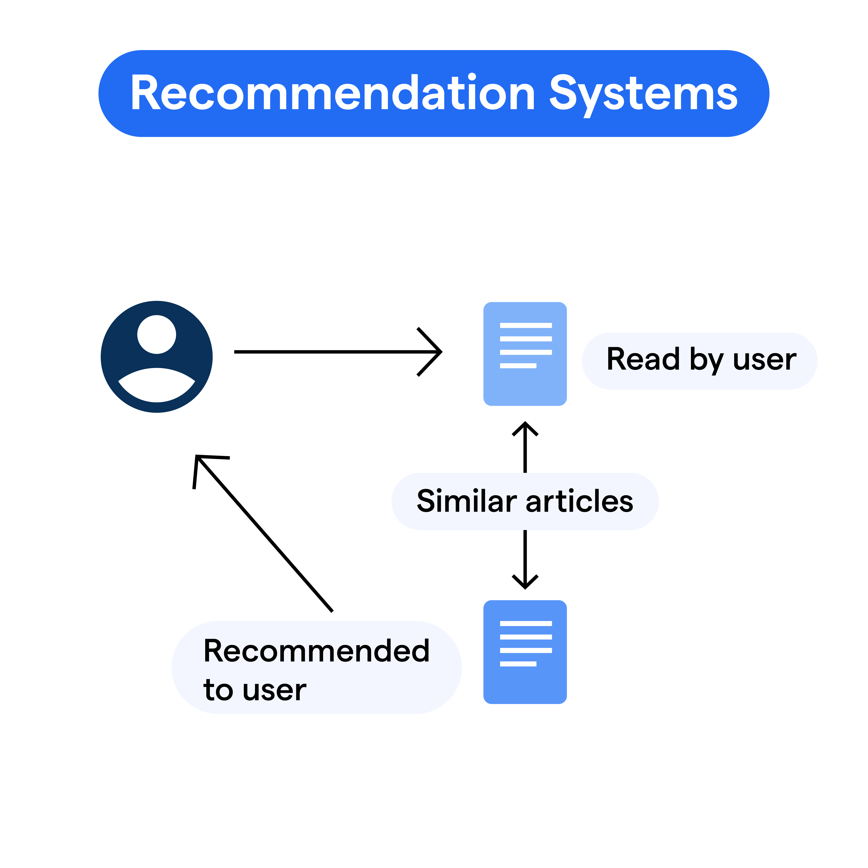
Recommender Systems
Suggests items to users based on past behavior or similarities.
Used in e-commerce, streaming services, and online learning platforms.
Types of Recommender Systems
Collaborative Filtering: Uses similarities between users or items.
Content-Based Filtering: Uses item features and user preferences.
Example: Movie Recommendation
Users rate movies (implicit or explicit feedback).
Identify users with similar interests.
Recommend movies based on preferences of similar users.
The machine learning algorithm for recommender systems is Matrix Factorization, such as Singular Value Decomposition (SVD), which decomposes user-item interaction matrices to find latent factors. Another common algorithm is Collaborative Filtering, which predicts user preferences based on similarities with other users.

Slide 14
Thank You
Notes:
Unsupervised learning is a powerful tool for discovering hidden patterns in data.
Techniques like clustering, PCA, anomaly detection, and recommender systems are widely used in industry.
Understanding these methods helps in exploratory data analysis and feature engineering.

